Slide 1

Deep Neural Network: Convolutional Neural Network (CNN), Part I
Mina Farmanbar
Associate Professor, University of Stavanger
for engineers

Slide 2
Shallow Neural Network
A shallow neural network consists of one hidden layer.
A network with many hidden layers and a large number of neurons in each layer is considered a deep neural network.
Also, unlike a shallow neural network which takes only input as vectors, deep neural networks are able to take raw data such as
images and text and automatically extract the necessary features to learn the data better.

Slide 3
Deep Neural Network
Deep neural networks work best when trained with large and large amounts of data
The more data you feed it the better it performs

Slide 4
Convolutional neural network (CNN)
Convolutional network is called CNN or ConvNet for short.
It is a network architecture for deep learning.
It takes input as images, and they learn directly from images.

Slide 5
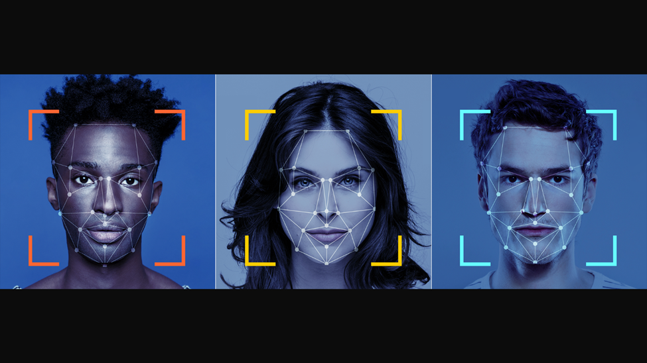
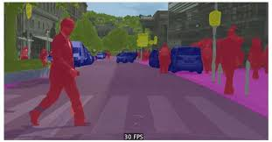
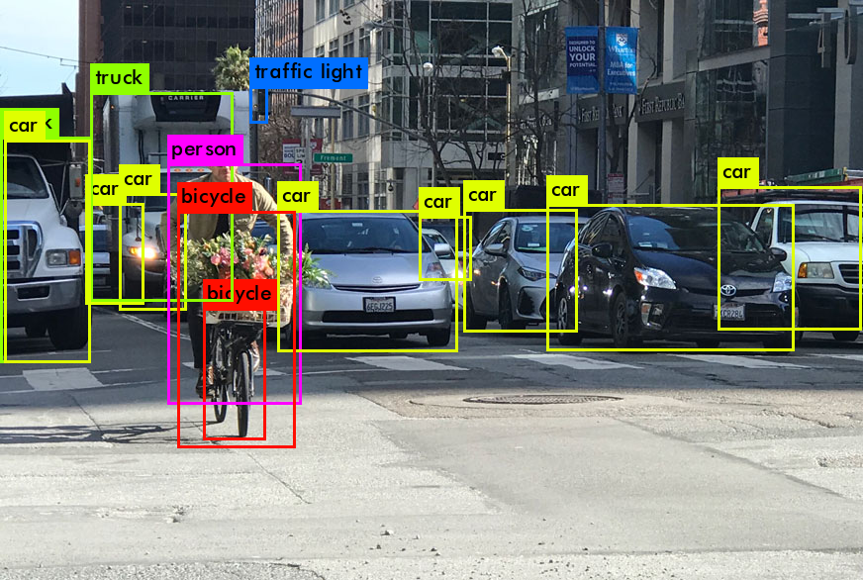
Convolutional neural network (CNN)
They solve problems involving:
Image recognition
Semantic segmentation
Object detection
https://theaisummer.com/static/8b58a02198e13d2e29a41b40e7c6a035/14b42/semseg.jpg
https://miro.medium.com/v2/resize:fit:975/1*FwgSuwjS8YP9UTYsr8SQ4Q.png
https://miro.medium.com/v2/resize:fit:872/0*ByD9YgAm-H--o70v.png

Slide 6
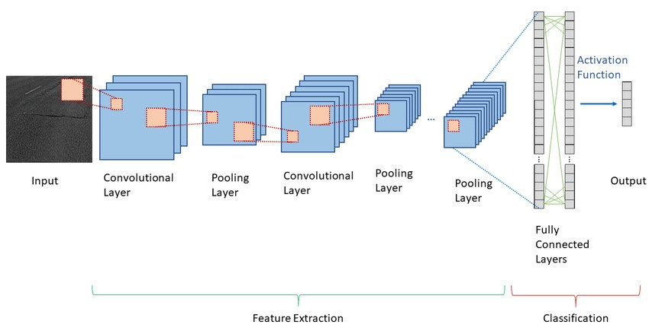
CNN Architecture
https://media.licdn.com/dms/image/D4E12AQGYlrPMNF_QgQ/article-cover_image-shrink_600_2000/0/1693868532308?e=2147483647&v=beta&t=bO63ST6uakSa-6vhR-9eYBQuu-bvG2v2Eo8a_0lltpE

Slide 7
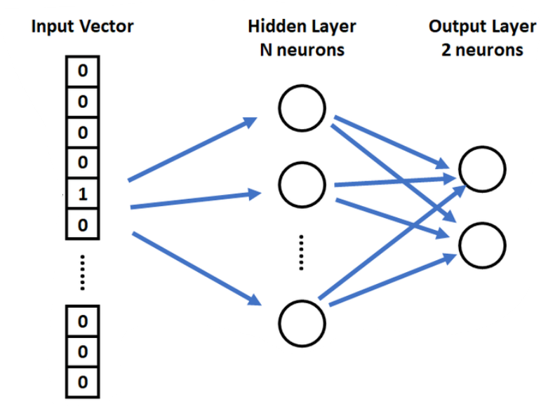
Input Layer in Conventional neural networks
Conventional neural networks take an ( n x 1) vector as their input.

Slide 8
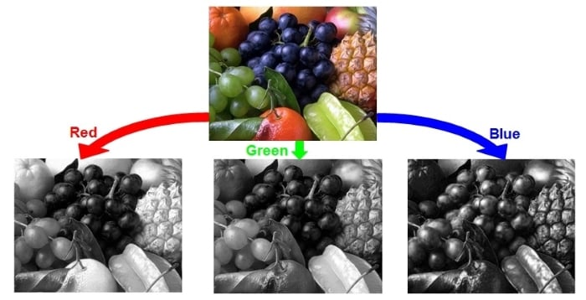
Input Layer in CNN
The input to a convolutional neural network, is mostly an (n x m x 1) for grayscale images or an (n x m x 3) for colored images, where the number 3 represents the red, green, and blue components of each pixel in the image.
for example, If we have a 100x100 image, that means we have 10,000 pixels sitting peacefully side by side in two dimensions
https://www.allaboutcircuits.com/uploads/articles/techart_colormodels_3_2.jpg

Slide 9
CNN inputs
One-dimensional data
signal and sequence (for example, a sequence of words)
Two-dimensional data
image and sound spectrogram
3D data
video and volumetric images (e.g. MRI images)
4D data
time-lapse volumetric images (such as functional MRI, fMRI)

Slide 10
Convolution Layer
The main core of the CNN network is the convolution layer, which accounts for the majority of convolutional neural network calculations.
Each convolution layer contains a set of filters, and the output is made from the convolution between the filters and the input layer.
The output of the convolution layer is called Feature Map.

Slide 11
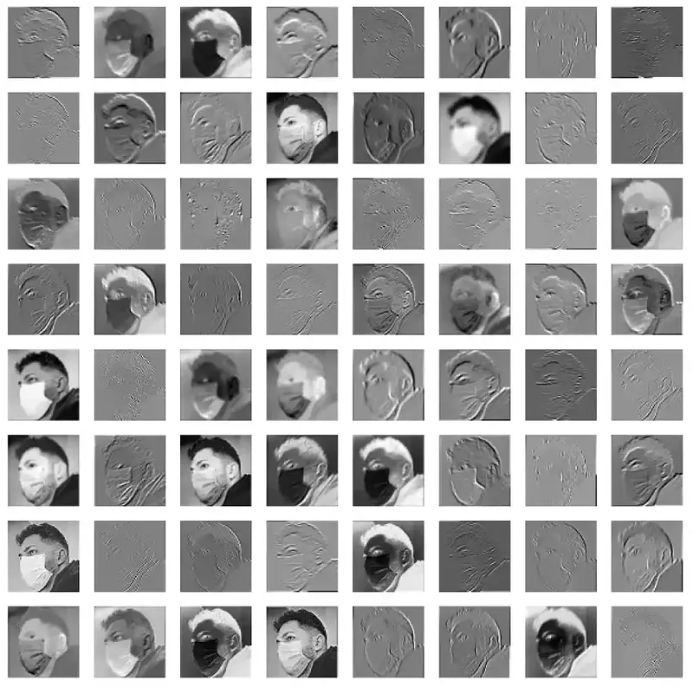
Convolution Layer
https://howsam.org/wp-content/uploads/2020/09/featuremap-output.webp

Slide 12
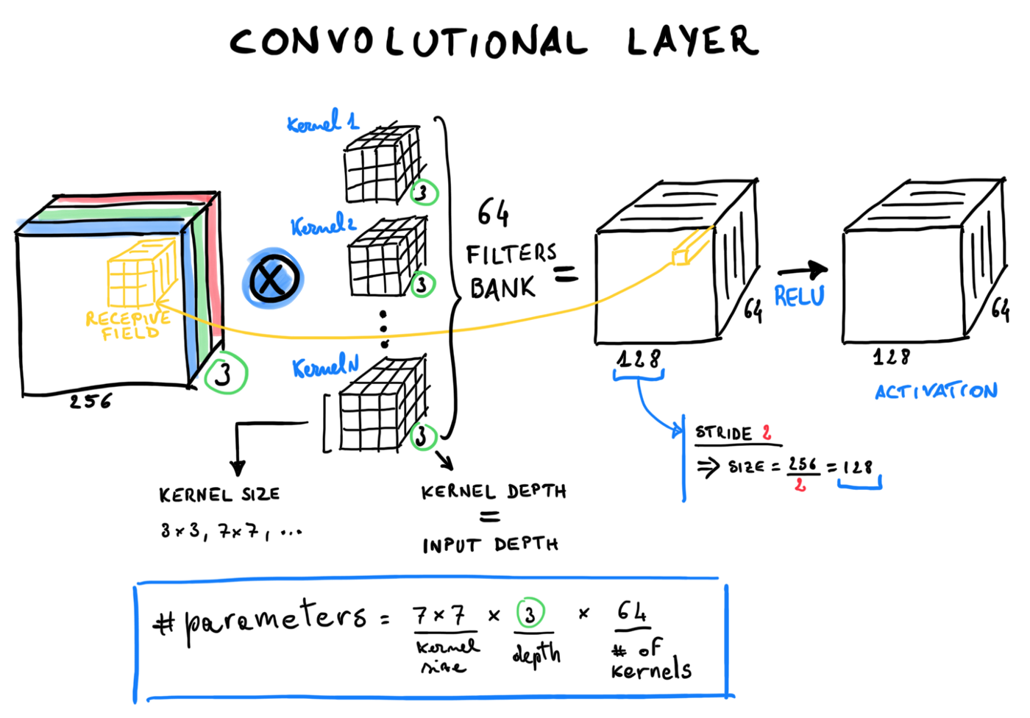
Convolution Layer
https://miro.medium.com/v2/resize:fit:720/format:webp/1*SVviXuPrUOScemSth8BM9g.png

Slide 13


Convolution Layer
25 | 110 | 65 | 0 | 34
15 | 14 | 10 | 54 | 66
65 | 76 | 54 | 200 | 210
176 | 5 | 73 | 67 | 89
63 | 90 | 95 | 111 | 175
124 | 75 | 54 | 100
90 | 64 | 254 | 276
81 | 127 | 267 | 299
95 | 168 | 178 | 264
0 | 1
0 | 1
$$×$$
$$=$$
$$\left(25∗0\right)+\left(110∗1\right)+\left(15∗0\right)+\left(14∗1\right)=124$$

Slide 14
Why did the convolution output size get smaller?!
Why is the output matrix 4x4, but the input matrix is 5x5?
Why are they not the same size?
There is a technique called matrix padding, which adds rows and columns around the input matrix, which prevents the reduction of the output dimension.

Slide 15
Convolution Layer
The filter size is usually defined as square (for images) and 3x3.
But 5x5 and 7x7 are also used sometimes.
With small filters, the number of learning parameters becomes much less.
why would we need to use convolution?
Why not flatten the input image into an n x m x 1 vector and use that as our input?

Slide 16
Convolution Layer
Imagine we have an image, and we want to create an input layer for these 9 pixels; We need to consider 9 neurons for the input layer of the MLP network.
1
1
0
4
2
1
0
2
1
1 | 1 | 0
4 | 2 | 1
0 | 2 | 1
Flattening

Slide 17
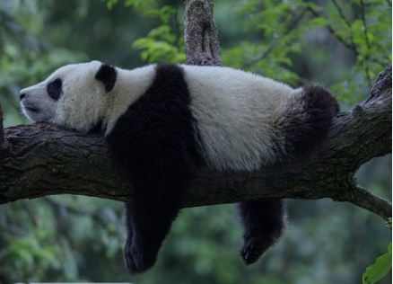
Convolution Layer
It is important not to change the structure of the image or the input and give the same original input to the network.
https://encrypted-tbn3.gstatic.com/images?q=tbn:ANd9GcRKQzbNfy6ZV4xl5dAXVLz-dgTlIq-IWUZ7Pidp0x0ZgVOFpqL6

Slide 18
Summary
Difference between shallow and deep neural network
We have seen the architecture of CNN
How input layer is organized
How convolution layer works

Slide 19
Thank you!
Mina Farmanbar
mina.farmanbar@uis.no

